Slide 1



RESTful Web Services with Spring
Mo’minjon Abduraimov
@MrDelphiGuru
The difference between a web service and a website is about who access it. The latter is accessed by human beings and former is accessed by programmed clients.

Slide 2

Who am I ?
Mo’minjon Abduraimov - @MrDelphiGuru or @DelphiGuru
Frontend Developer (Learning Backend ! )
Delphi, C++ & Java {FMX, VCL, Spring, DataSnap, FireDAC … frameworks}
Delphi.uz
Github.com/DelphiUz

Slide 3
Objectives
At the end of this presentation, the participant will be able to:
Understand the basics of the HTTP protocol.
REST Vs. SOAP; When to choose REST?
Understand how REST web services fit onto the HTTP protocol.
RESTful Spring Data Web Service (demo)
Hypersonic 2 database - Runtime
CRUD Repositories

Slide 4
Introduction to REST
REST stands for Representational State Transfer
REST is an architectural style, which provides direction for building distributed and loosely coupled services.
REST is not linked to any particular platform or technology - it's an idea to develop services to function similar to the Web.
REST web services communicate over the HTTP specification, using HTTP vocabulary:
Methods (GET, POST, etc.)
HTTP URI syntax (paths, parameters, etc.)
Media types (xml, json, html, plain text, etc)
HTTP Response codes.

Slide 5
Introduction to REST
Representational
Clients possess the information necessary to identify, modify, and/or delete a web resource.
State
All resource state information is stored on the client.
Transfer
Client state is passed from the client to the service through HTTP.

Slide 6
Introduction to REST
The six characteristics of REST:
Uniform interface
Decoupled client-server interaction
Stateless
Cacheable
Layered
Extensible through code on demand (optional)
* Services that do not conform to the above required contstraints are not strictly RESTful web services.

Slide 7
REST Vs. SOAP: When to choose REST ?
Simple Object Access Protocol (SOAP) depends primarily on XML to provide messaging services.
SOAP uses different protocols for communication, such as HTTP, SMTP or FTP.
REST on the other hand, is an architectural style, which uses existing HTTP actions and methods and does not create any new standards. SOAP on the other hand, is a protocol.

Slide 8
REST is more flexible compared to SOAP web services. It has following benefits over SOAP:
SOAP uses only XML for messages, REST supports different formats
REST messages are smaller in size and consume lesser bandwith.
REST if better in terms of performance with better caching support.
There is less coupling between REST Clients (browsers) and Servers.
REST should be choosen when you have to develop a highly secure and complex API, which supports different protocols.
Although SOAP may be a good choice, REST may be better when you have to develop lighweight
APIs with great performance and support for CRUD operations.

Slide 9
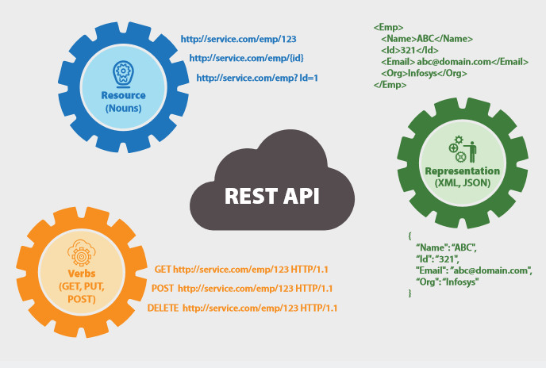

Slide 10
HTTP-REST Request Basics
The HTTP request is sent from the client.
Identifies the location of a resource.
Specifies the verb, or HTTP method to use when accessing the resource.
Supplies optional request headers (name-value pairs) that provide additional information the server may need when processing the request.
Supplies an optional request body that identifies additional data to be uploaded to the server (e.g. form parameters, attachments, etc.)

Slide 11
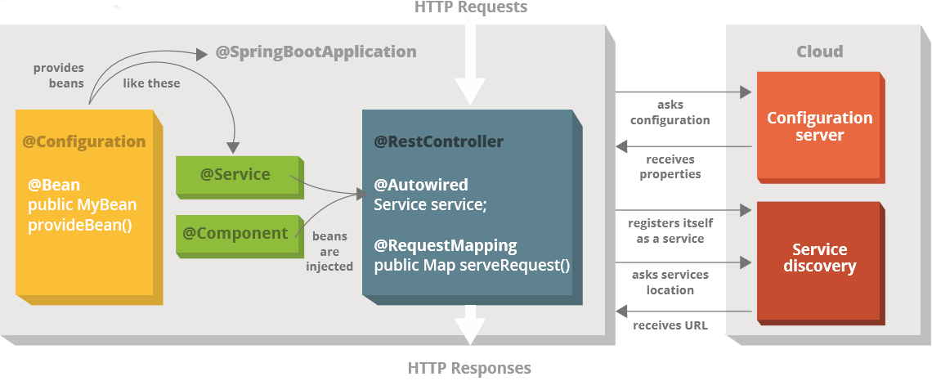
HTTP Requests and Responses

Slide 12
HTTP-REST Request Basics
Sample Client Requests:
A typical client GET request:
A typical client POST request:
GET /view?id=1 HTTP/1.1
User-Agent: Chrome
Accept: application/json
[CRLF]
Requested Resource (path and query string)
Request Headers
(no request body)
POST /save HTTP/1.1
User-Agent: IE
Content-Type: application/x-www-form-urlencoded
[CRLF]
name=x&id=2
Requested Resource (typically no query string)
Request Headers
Request Body (e.g. form parameters)

Slide 13
HTTP-REST Response Basics
The HTTP response is sent from the server.
Gives the status of the processed request.
Supplies response headers (name-value pairs) that provide additional information about the response.
Supplies an optional response body that identifies additional data to be downloaded to the client (html, xml, binary data, etc.)

Slide 14
HTTP-REST Response Basics
Sample Server Responses:
Response Status
HTTP/1.1 200 OK
Content-Type: text/html
Content-Length: 1337
[CRLF]
<html>
<!-- Some HTML Content. -->
</html>
Response Headers
Response Body (content)
HTTP/1.1 500 Internal Server Error
Response Status
HTTP/1.1 201 Created
Location: /view/7
[CRLF]
Some message goes here.
Response Status
Response Header
Response Body

Slide 15
A typical HTTP REST URL
http://my.store.com/fruits/list?category=fruit&limit=20
protocol
host name
path to a resource
query string
The protocol identifies the transport scheme that will be used to process and respond to the request.
The host name identifies the server address of the resource.
The path and query string can be used to identify and customize the accessed resource.

Slide 16
HTTP and REST
A REST service framework provides a controller for routing HTTP requests to a request handler according to:
The HTTP method used (e.g. GET, POST)
Supplied path information (e.g /service/listItems)
Query, form, and path parameters
Headers, cookies, etc.

Slide 17
Producing REST Services
REST services in Java web applications can be implemented in several ways:
As a plain Java Servlet
Adequate for very simple REST services.
Requires a lot of “boiler plate” code for complex services.
Using a REST service framework.
Eliminates the need to write “boilerplate” code.
Typically integrates with other technologies, such as Spring.

Slide 18
What does Spring offer?
Dependency Injection
Also known as IoC (Inversion of Control)
Inversion of control takes the integration and configuration of the system out of the application, and instead performs dependency injection.
Aspect Oriented Programming
Runtime injection-based
Service Abstractions
ORM, DAO, Web MVC etc.
Allows access to these without knowing how they actually work

Slide 19
What does Spring offer?
Enable applications to be coded from POJOs
Allow enterprise services to be applied to those POJOs in a declarative, non-invasive way
Collaborating instances are injected using plain Java constructors or setter methods
Decouples your application objects from their environment
Switch to global transactions over JTA
Export your business objects in different environments
Switch between SLSB, web service etc.

Slide 20
What does Spring offer?
Core Lightweight Container(The heart of Spring)
Aspect-Oriented Programming (AOP) framework
Modularizes behavior that would otherwise be scattered through different methods
Decorates your POJOs with cross-cutting behavior in a transparent manner
Container instantiates objects and injects dependencies on collaborating objects and configuration properties through Java methods

Slide 21
Benefits
Portability
Your core business logic is implemented once and runs anywhere
Leverage
Your core code is decoupled from volatile infrastructure
Consistency
Common configuration strategy everywhere
Productivity
Test-driven development
Don’t need to reinvent your own infrastructure

Slide 22
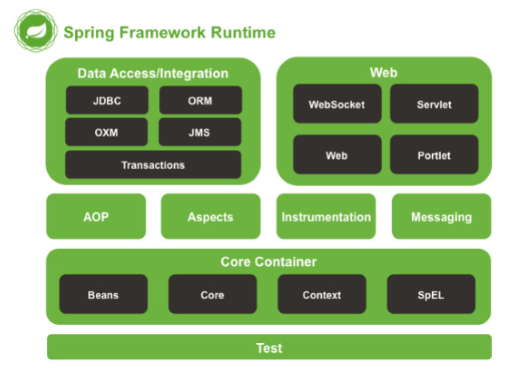

Slide 23
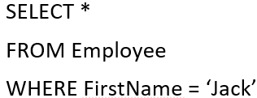

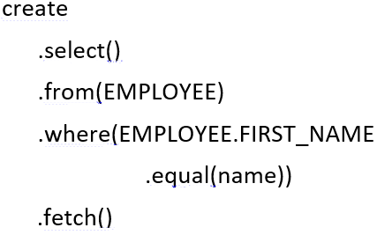
Why are we still writing …. ?!
SQL :
JPA :
jOOQ :

Slide 24

CRUD Repositories

Slide 25
CRUD and JPA Repositories
JpaRepository extends PagingAndSortingRepository which in turn extends CrudRepository.
CrudRepository mainly provides CRUD functions
PagingAndSortingRepository provide methods to do pagination and sorting records.
JpaRepository provides some JPA related method such as flushing the persistence context and delete record in a batch.
Because of the inheritance mentioned above, JpaRepository will have all the functions of CrudRepository and PagingAndSortingRepository. So if you don't need the repository to have the functions provided by JpaRepository and PagingAndSortingRepository , use CrudRepository.

Slide 26

RESTful WebService Application - Demo

Slide 27
CONCLUSION
By designing web services through adopting RESTful guidelines and best practices,your application can best utilize the in-built features of a web platform and the HTTP protocol.
REST provides a superb way to implement services with inherited features such as uniform interface and caching.
Developers can enhance productivity and develop loosely coupled web services by adopting the best REST practices.

